Slide 1
SWOT ANALYSIS
By- ADITYA SINGH RATHORE

Slide 2

STRENGTH
TIME MANAGEMENT- I am good at managing time. I am able to take out time to study, watch TV, play video games and I am still left with a lot of time.
OPTIMISTIC- I am very optimistic and I often end up finding good in bad.

Slide 3
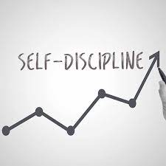
DISCIPLINED- I am a disciplined student and am in full control how I spend my time.
STRATEGIC THINKER- I often end up creating a full strategy of how I would be completing my work or be preparing for any examination.
CONFIDENT- I have a deep sense of confidence, in fact I believe in myself more than anyone else.

Slide 4
WEAKNESS
POOR PEOPLE SKILLS- Though I am good at addressing a crowd about a certain topic but my interpersonal communication skills aren’t up to the mark.
POOR HANDWRITING- My handwriting is really pathetic. I have been told by many teachers to improve my handwriting.

Slide 5
OPPORTUNITIES
I am good at public speaking so I have won prizes in speech competitions and extempore.
I have won prizes in chess competition.
I have won prizes in olympiads.

Slide 6
THREATS
Distracted- I get distracted easily. I find that I am not able to study when the temperature is too high or there are noises in the background. This is why I am not able to study during free periods at school.
Lazy- I am quite lazy sometimes and it takes a lot of encouragement or motivation to even make myself convinced to complete my school assignments.

Slide 7
Thank You

